Slide 1


Autocorrelation
Wake Forest
School of Business
_______

Slide 2
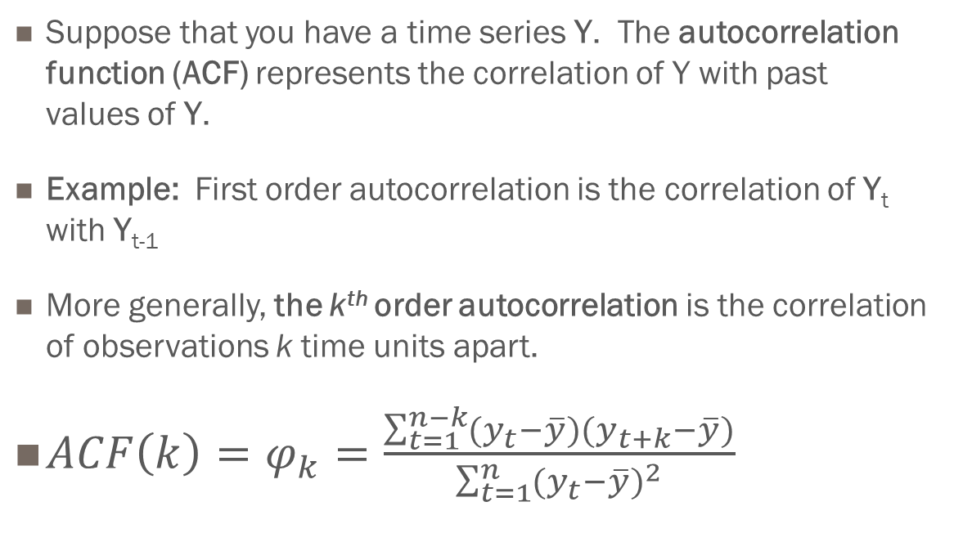
Autocorrelation
Suppose that you have a time series Y. The autocorrelation function (ACF) represents the correlation of Y with past values of Y.
Example: First order autocorrelation is the correlation of Y_{t} with Y_{t-1}
More generally, the k^{th} order autocorrelation is the correlation of observations k time units apart.
$ACF\left(k\right)=φ_{k}=\frac{\sum_{t=1}^{n−k}{(y_{t}−\overline{y})(y_{t+k}−\overline{y})}}{\sum_{t=1}^{n}{{(y_{t}−\overline{y})}^{2}}}$

Slide 3
Autocorrelation
The sample ACF can help to identify features that should be included in a forecast model.
The sample ACF can be used to provide estimates of forecast model parameters

Slide 4
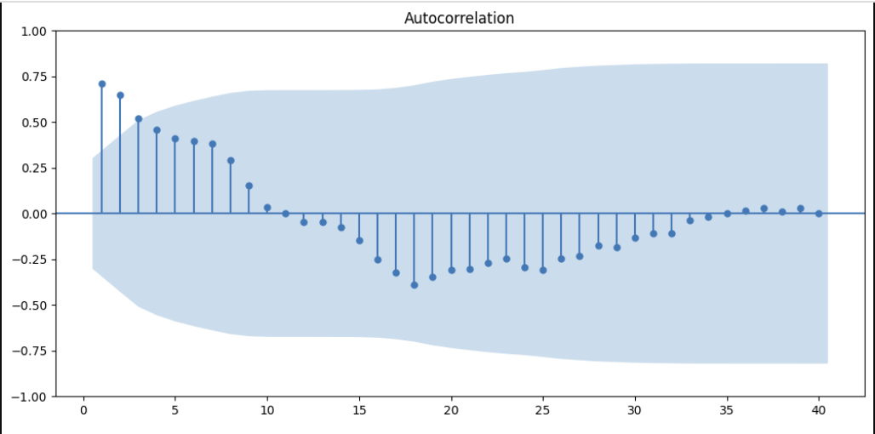
Interpreting the ACF
NOTE: The choice of a 95% confidence interval for the sample ACF is arbitrary.
NOTE: A statistically significant result can be spurious. One common cause of a spurious result is the proximity effect.

Slide 5
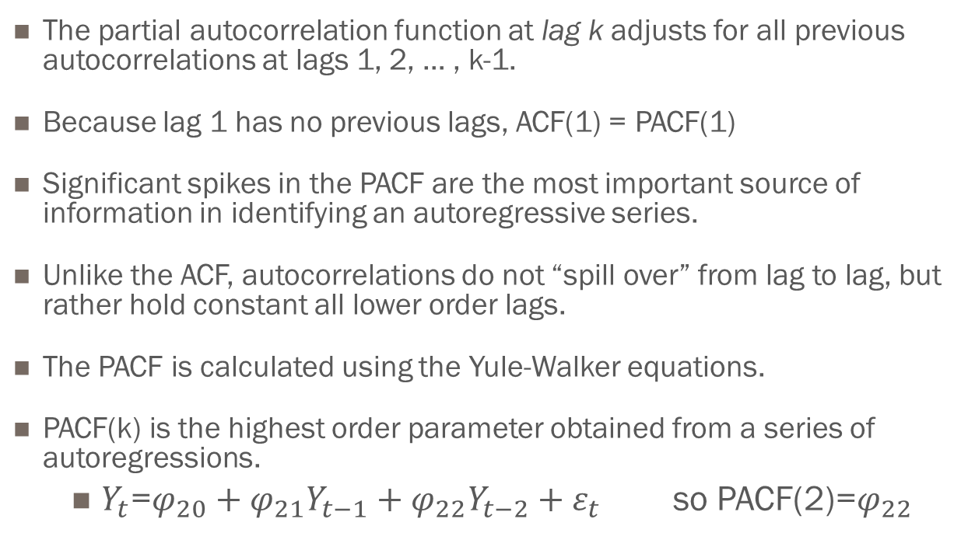
Partial Autocorrelation Function (PACF)
The partial autocorrelation function at lag k adjusts for all previous autocorrelations at lags 1, 2, … , k-1.
Because lag 1 has no previous lags, ACF(1) = PACF(1)
Significant spikes in the PACF are the most important source of information in identifying an autoregressive series.
Unlike the ACF, autocorrelations do not “spill over” from lag to lag, but rather hold constant all lower order lags.
The PACF is calculated using the Yule-Walker equations.
PACF(k) is the highest order parameter obtained from a series of autoregressions.
$Y_{t}$=$φ_{20}+φ_{21}Y_{t−1}+φ_{22}Y_{t−2}+ε_{t}$ so PACF(2)=$φ_{22}$

Slide 6
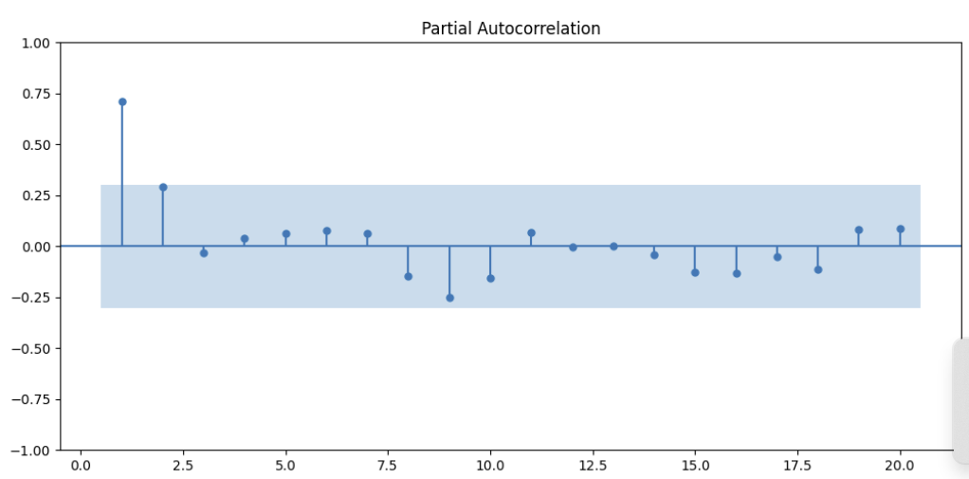
Interpreting the PACF

